Slide 1

Go Track
PowerUp! SG Tech Traineeship – Software Engineering

Slide 2
Learning Objectives – Mod 7
At the end of the course, participants should be able to:
Define the structure of a Function.
Identify the different elements that make up a Function.
Demonstrate the use of a Function.
Examine the difference of a Function and a Method.
Describe what an interface is.
Identify the different components for an interface.
Demonstrate the use of an interface with a simple application.
Identify the different reflection components.

Slide 3
Function
Introduced by keyword func
Wrap up a sequence of statements as a unit that can be used several times in a program.
Value of uninitialised variables of function type is nil.
Syntax
func (receiver) identifier (parameters) (returns) {
/* code block ….. */
}
There is no default parameter values. Go does not specify names for arguments. instead, every parameter must be provided in correct order and type.

Slide 4
Function
Function with results must end with a return statement.
Sequence of results and parameters of the same type can be factored.
func f(a, b, c int, d, e, string, f, g float32){
/*… code block … */
}
Go supports result variables. Named results aids in documentation except final boolean or error results which need not be explained.
func sum(a, b, c int) (result int) { result = a + b + c return }
func sum(a, b, c int) int { result = a + b + c return result }

Slide 5
Scope
package main import ( "fmt" ) var a int = 20 var b int = 50 func main() { fmt.Println(sum(a, b)) a = 50 fmt.Println(sum(a, b)) } func sum(a, b int) int { c := a+ b return c }
Extent of source text that an identifier denotes.
Go uses blocks to scope the content.
Predeclared identifier is universe block
Declared identifier at top level ( outside all function) is the package block
Declared identifier for method receiver, function parameter or result variable is within the function body block.
Declared type identifier inside function is within the function body block

Slide 6
Function
func main ( ) {
result := sum ( 10 , 5 )
fmt.Println ( result )
}
func sum ( number1, number2 int) int{
result = number1 + number2
return result
}
>>>15
Simple function call and return
“func sum” before or after “func main” has no difference.

Slide 7
Function
Technical terms
Parameters are part of the syntax
Arguments are passed to function
func identifier (arguments) ( )
func (receiver) identifier (parameters) (returns) { /*… code block … */ }

Slide 8
Function
If two or more consecutive named parameters share a type, can omit from all but the last.
func add ( x, y, z int) int { /*… code block … */ }
func add (x, y, z int, a, b, c float32) int { /*… code block … */ }

Slide 9
Function
func functionName() type { /*… code block … */ return value } func add(a, b int) result int{ result = a + b return } func first( a, _ int) int { return a }
Single Function returns.
Result variables may be named.
Well chosen names of result will allow for well documentation – except bool or error result which are self explanatory
Blank identifiers can be used.

Slide 10
Function
type Particulars struct{ firstName string lastName string } customer := Particulars{ “John”, “Doe”}
Blank identifier returns
Enforce certain information.
Used as a key to enforce input
type Particulars struct{ firstName string lastName string _ struct { } } customer := Particulars{ “John”, “Doe”}

Slide 11
Function
Multiple returns are supported
Result is a tuple of values
Can use to determine if computation worked
Typically, multiple response values assigned to variables or blank identifier.
func functionName(a, b type) type { /*… code block … */ return c, d } func calSqrt(a float64) (result float64, ok bool){ if a >= 0 { result = math.Sqrt(a) ok = true } return result, ok }

Slide 12
Function
Blank identifier returns
Drops the data of unwanted information.
func shippingCost(length, width, height float64) (float64, float64) { var airCost = length * width * height * 1.25 var shippingCost = length * width * height * 0.75 return airCost, shippingCost } func main() { costByAir, _ := shippingCost(10.5, 12.6, 17.5) fmt.Printf("Cost by Air is $%.2f", costByAir) }

Slide 13
Function
Bare return
Named results are used, operands of return can be omitted.
Reduce code duplication.
Suffers from readability of code.
func calSqrt(a float64) (result float64, ok bool){ if a >= 0 { result = math.Sqrt(a) ok = true } return } func calSqrt(a float64) (result float64, ok bool){ if a < 0 { return } return math.Sqrt(a), true }

Slide 14
Function
Go reserves two functions for special purposes.
init()
main()
Both defined as taking no arguments and return nothing.
Note: This traversing method is only applicable AFTER building the project.
Main Import package1 var … … const … … init() main()
Package 1 Import package2 var … … const … … init() main()
Package 2 var … … const … … init() main()

Slide 15
Function
With and without build
package main
import "fmt”
func init() {
fmt.Println("init at main.go")
}
func main() {
fmt.Println("main")
}
With Build
package main
import "fmt"
func init() {
fmt.Println(“Init at second.go")
}
Without Build
Flow of function calls are also dependent on the order that files are presented to the compiler

Slide 16
Function
Variadic parameter
A type prefixed with “...”
Can be zero or more arguments for the parameter
allows for passing of multiple elements in a slice format.
Variadic argument
An argument composed of multiple elements
A type postfixed with “...”
Can be zero or more elements in the argument
A function with variadic parameter is a variadic function.
func (receiver)(… parameter) return { /*… code block … */ }
func sum( vals … int) int{ total := 0 for _, val := range vals{ total += val } return total } fmt.Println(sum()) fmt.Println(sum(3)) fmt.Println(sum(1, 2, 3))

Slide 17
Function
Use of Variadic function
func find(num int, nums ...int) { fmt.Printf("type of nums is %T\n", nums) found := false for i, v := range nums { if v == num { fmt.Println(num, "found at index", i, "in", nums) found = true } } if !found { fmt.Println(num, "not found in ", nums) } fmt.Printf("\n") }
func main() { find(89, 89, 90, 95) find(45, 56, 67, 45, 90, 109) find(78, 38, 56, 98) find(87) }

Slide 18
Function
Variadic argument
An argument composed of multiple elements
A type postfixed with “...”
Can be zero or more elements in the argument
A function with variadic argument call
<function_name>( variable…)
func main() { nums := [ ]int{1, 2, 3, 4} sum(nums...) } func sum(nums ...int) { fmt.Print(nums, “ answer: ") total := 0 for _, num := range nums { total += num } fmt.Println(total) }

Slide 19
Function
Callback
Passing a function as an argument
Making use of the function syntax
func expression
assigning func to a variable x
func functionName() func() type { return func() type{ /*… code block … */ } } func main() { x := functionName() }

Slide 20
Function
Example of function as argument
Anonymous functions
Defines inline function wihtout naming it.
The function func() int is passed as a return argument from wrapper()
A closure is formed until next assignment
func wrapper() func() int { var x int return func() int { x++ return x } } func main() { increment := wrapper() fmt.Println(increment()) fmt.Println(increment()) }

Slide 21
Function
Example of using callback typed as a function variable
func main() { printSlice( [ ]int { 1, 2, 3, 4, 5 }, func(n int) { fmt.Println(n) }) } func printSlice(numbers [ ]int, callback func(int)) { for _, n := range numbers { callback(n) } }
var callback func(int)

Slide 22
Function
Function with custom type using slice example
Applicable to development of a simple menu with calculator.
type newFunction func(int, int) int var a = 1 var b = 2 funcSet := [ ] newFunction{ func(a int, b int) int { return a+b}, func(a int, b int) int { return a-b}, func(a int, b int) int { return a*b}, func(a int, b int) int { return a/b}, } var fn = funcSet[0] fmt.Println(“a+b = “, fn(a, b))

Slide 23
Function
Recursion of functions
A function calling itself
Important to identify an exit condition from the function to avoid infinite loop.
May be costly to implement if not done properly.
func functionName() type{ if condition{ return } return functionName() }

Slide 24
Function
Recursion example
func countdown (counter int) { if(counter == 0) { fmt.Println(“0") return } else { fmt.Println(counter) countdown (counter-1) } } func main() { countdown(5) }

Slide 25
Function
Defer in functions
keyword “defer”
defer the function/ method call execution until enclosing function returns or function ends abnormally via panic.
Useful for releasing resources.
Closing files
Network connections
Mutex
openFile, err:= os.Open(“file.txt”) If err != nil{ log.Fatal(err) } defer openFile.Close() /*… code block … */

Slide 26
Further examples for defer
Follows Last In First Out (LIFO)
func sum(a, b int) { result := a + b fmt.Println(result) } func main() { fmt.Println("This is the first in") defer fmt.Println("This is the last in") defer sum(10, 20) defer sum(1, 1) }
func main() { fmt.Println("counting") for i := 0; i < 10; i++ { defer fmt.Println(i) } fmt.Println("Starting countdown") }

Slide 27
Method
When a func is attached to a type, it becomes a method of that type.
Can be called through that type using the “dot” notation.
Make use of the “receiver” of func syntax
Method linked to type totalCost using tc
type totalCost float64 func (tc totalCost) Total() float64 { tc = tc + tc * 0.07 return float64(tc) }

Slide 28
Method
type totalCost float64 func (tc totalCost) Total() float64 { tc = tc + tc * 0.07 return float64(tc) } func main(){ var tc totalCost = 1 fmt.Println(tc.Total()) fmt.Println(tc.Total()) }
>>> output : 1.07 1.07
Value receiver
Value of totalCost is copied and passed to the method.
Does not change.

Slide 29
Method
Pointer receiver
Attaches the Total func to the totalCost pointer type
Dereferencing the pointer to have access to the actual content with “ *type ”
type totalCost float64 func (tc *totalCost) Total() float64 { *tc = *tc + *tc * 0.07 return float64(*tc) } func main(){ var tc totalCost = 1 fmt.Println(tc.Total()) fmt.Println(tc.Total()) }
>>> output : 1.07 1.1449

Slide 30
Method
Setting method to function using receiver type
type MyStr string func (s MyStr) Uppercase() string { return strings.ToUpper(string(s)) } func main() { fmt.Println(MyStr(”Go Track").Uppercase()) }

Slide 31
Interface
Means of protocol
Abstract type and has no implementations
Only describes the expected behavior from a type
A collection of method signatures.
Use of keyword “interface”
type <interface name> interface { /*… code block … */ }
Polymorphism for Go.

Slide 32






Interface
Consider the USB interface
Serves power and data.
Does not know what is plugged on its end.
Items plugged could be
Mini fan
Thumbdrive
LED light
printer and much more.
But all the items that plug into USB must have at least a power line and/ or a data line.

Slide 33
Interface
Consider fmt.Stringer (Build-in interface code)
Consider a print application to print either shopping cart or quantity count.
To use this interface, we need to implement exact signature for two different functions with different content. (like USB pins)
fmt.String interface
type Stringer interface{ String() string }
Count function
Print shopping cart function
type quantityCount int func (qc quantityCount) String() string{ return strconv.Itoa(int(qc)) }
type shoppingCart struct{ itemName string itemCost string } func (sc shoppingCart) String() string{ return fmt.Sprintf(“Shopping Cart : %s - %s” , sc.itemName, sc.itemCost) }

Slide 34
Interface
Common action that is needed. (like USB plug )
Both shoppingCart and quantityCount can “call” printReport() function to print their respective information
func printReport(report fmt.Stringer){ log.Println(report.String()) } shoppingCart1 := shoppingCart{“laptop”, “1500”} printReport(shoppingCart1) quantityCount1 := quantityCount(10) printReport(quantityCount1)

Slide 35
Interface
Scenario example
Furniture Methods
Buy Sofa
Orders Interface
Shipping Cost Output
Total Amount Payable
Buy Table
Clothing Methods
Buy Winter Clothing

Slide 36
Interface
Declaration of interface and its method signatures
package main Import “fmt” var( largeItemCost = 3.00 smallItemCost = 5.00 extendedWarranty = 0.1 ) type order interface{ shippingCost() float64 cost() float64 }
Arbitrarily set values
Declared interface and method signature

Slide 37
Interface
Declaration of attributes of each object
type furniture struct{ length, height, depth, price, quantity float64 } type clothes struct{ weight, price, quantity float64 }

Slide 38
Interface
Declaration of method signatures syntax
func (furn furniture) shippingCost() float64{ return furn.length * furn.height * furn.depth * largeItemCost } func (furn furniture) cost() float64{ return furn.price * furn.quantity + furn.price * extendedWarranty } func (cl clothes) shippingCost() float64{ return cl.weight * smallItemCost } func (cl clothes) cost() float64{ return cl.price * cl.quantity }

Slide 39
Interface
Object creation and link to interface
func totalCost(o order){ fmt.Println(o) fmt.Println(o.shippingCost() + o.cost()) } func main(){ cl := clothes{weight: 3.5, price: 15.00, quantity: 3} furn:= furniture{length: 3, height: 2, depth: 1, price:100, quantity:1} totalCost(cl) totalCost(furn) }

Slide 40
Reflection
In computer science, reflection is the ability of a process to examine, introspect, and modify its own structure and behavior.
--- J. Malenfant, M. Jacques and F.-N. Demers
Source
https://web.archive.org/web/20170821214626/http://www2.parc.com/csl/groups/sda/projects/reflection96/docs/malenfant/malenfant.pdf

Slide 41
Reflection
Allow to examine and modify values at runtime.
variables
functions
structs
Uses the “reflect” package
Gather information on the application
Gather the types, values and objects of the application.
Modify values of the application at runtime.

Slide 42
Reflection
Usage
A function to satisfy a common interface for different types of values
There is no known representation of a function
The function does not exist during the development of the source code.
Practically
Testing
Formatting output
Reading and writing from the database (database/ sql)
Marshaling and Unmarshaling data (encoding Json or xml)
Writing out templates

Slide 43
Reflection
Consider fmt print function
Ability to print arbitrary value of any type
Includes user-defined type.
Permutation infinite.
func Println(x interface{}) string { switch x:= x.(type){ case string: return x case int: return strconv.Itoa(x) case float32: /*… code block … */ } }
Infinite cases

Slide 44
Reflection
Consist of three core items
Types
Kinds
Values

Slide 45
Reflection
To examine Types
Make use of reflect.TypeOf(var) to get the type variable.
From the variable, use
Name() to get name of the type
The name of the type that is given.
Kind() to get the kind of the type
slice, map, pointer, struct, etc
type student struct{ studentID int studentName string } student1:= student{ studentID:12345, studentName: “John”, } xt := reflect.TypeOf(student1) fmt.Println(xt.Name()) fmt.Println(xt.Kind()) >> student >> struct

Slide 46
Reflection
To read
Make use of reflect.ValueOf(var)
To set
Make use of reflect.ValueOf(&var)
From the variable, use Elem().Set<type>(new value)
x:= “hello” xt:= reflect.ValueOf(x) fmt.Println(xt) >>hello
x:= "Hi" xv:= reflect.ValueOf(&x) xv.Elem().SetString("Hello") fmt.Println(x) >>> Hello

Slide 47
Reflection
To create
Make use of reflect.New(varType) passing in a type for variable to create
From the variable, use Elem().Set<type>( new value)
From the variable, use Elem.Interface() to dereference the pointer as Go does not have generics
x:= “” xt:= reflect.TypeOf(x) xv:= reflect.New(xt) xv.Elem().SetString(“Hello”) xv= value.Elem().Interface() fmt.Println(x) >> Hello

Slide 48
Learning Objectives – Mod 8
At the end of the course, participants should be able to:
Define the structure of Go code based on best practice reference.
Define the components for Go Documentation.
Create Go Documentation syntax from code.
Identify the different best practice in writing Go code.
Demonstrate the different best practice of writing Go code.

Slide 49
Structure of Go Project
Wide range of structuring Go Projects
Somewhat contentious subject.
Basic first project all under one folder with maybe one file
Results in inter dependencies.
Reuse could be difficult as code designed for one package.
Only one main method.

Slide 50
“Style” options
Application/
main.go
list.go
utils.go
users.go
...
Simple structure
Simplest to begin with.
Direct and simple to audience.
No cognitive overhead compared to a complex structure.
Benefits for
Microservices
Distributed tiny applications.
Small tools and libraries
Small tasks/ commands

Slide 51
“Style” options
rest-api/
main.go
user/
user.go
login.go
registration.go
articles/
articles.go
utils/
common_utils.go
...
...
Modularized/ Grouped structure
Medium to large sized applications.
Modularizing in mind.
Grouping of functionality/ shared logic shared.
Code maintenance in mind.

Slide 52
“Style” options
Matured and split
Project grows over time and becomes matured.
Potential sub portions can be identified and split into its own.
Use of independent repositories to manage own lifecycle.
Good for segregation of work.
New development can carry out without intruding to main application.
Increased overhead in maintenance of new repository.

Slide 53
“Types” of folders
/cmd folder
Contains main application files, with directory matching name of the binary.
E.g. /cmd/simple-command/simple-command.go
/internal folder
Only accessible to parent root directory.
Additional to existing lowercase and uppercase function visibility rules.
Introduced since Go 1.4, https://golang.org/doc/go1.4##internalpackages
/pkg folder
Public library files used by application or external applications

Slide 54
Go Documentation
Go style encourages good documentation of package APIs.
Each declaration of an exported package member and the package declaration itself should precede with a comment explaining its purpose and usage.
Go doc comments are always complete sentences. First sentence is usually a summary that starts with the name being declared. Function parameters and other identifiers are mentioned without quotation or markup.

Slide 55
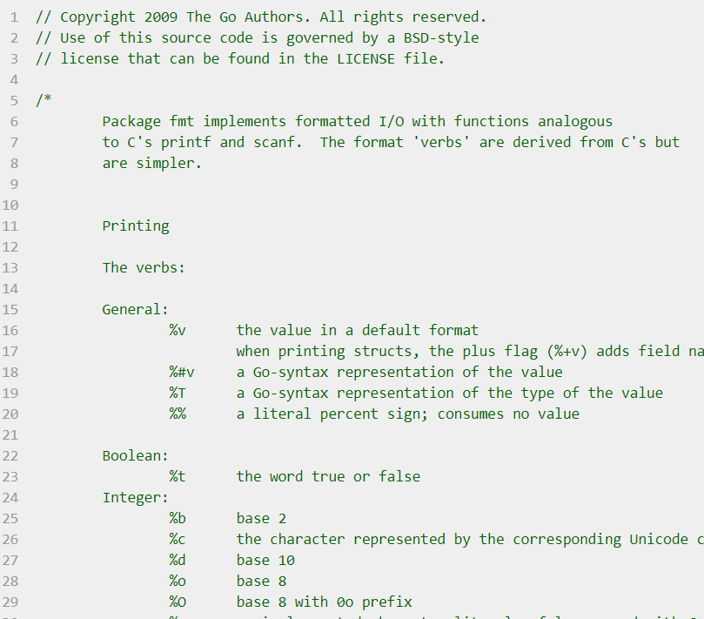
Go Documentation
Let us take a look at the fmt package as an example.

Slide 56
Go Documentation
doc comment for package:
Comment immediately preceding a package declaration is considered as doc comment for the package as a whole.
This comment must only be one, though it may appear in any file in the package.
Longer package comments may warrant a file of their own. This file is usually called doc.go
e.g. src/fmt/doc.go
first sentence will appear in godoc’s package list
doc comment for function e.g. fmt.Fprintf:
//Fprintf formats according to a format specifier and writes to w.
//It returns the number of types written and any write error encountered.
Func Fprintf(w io.Writer, format string, a …interface{}) (int, error)

Slide 57
Go Documentation
Good documentation need not be extensive.
Documentation is no substitute for simplicity.
Go’s conventions favour brevity and simplicity in documentation as well, as in all other things of the programming language (since documentation requires maintenance too)
Many declaration can be explained in one well-worded sentence.
If behaviour is obvious, no comment is needed.
You will be able to find several good examples in Go standard library.

Slide 58
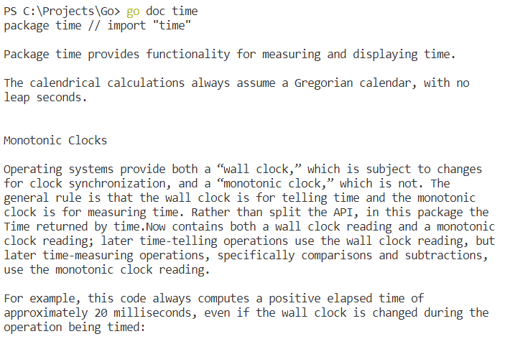
Go Documentation
The go doc tool prints the declaration and doc comment of the entity specified in the command line:
Which may be a package:

Slide 59
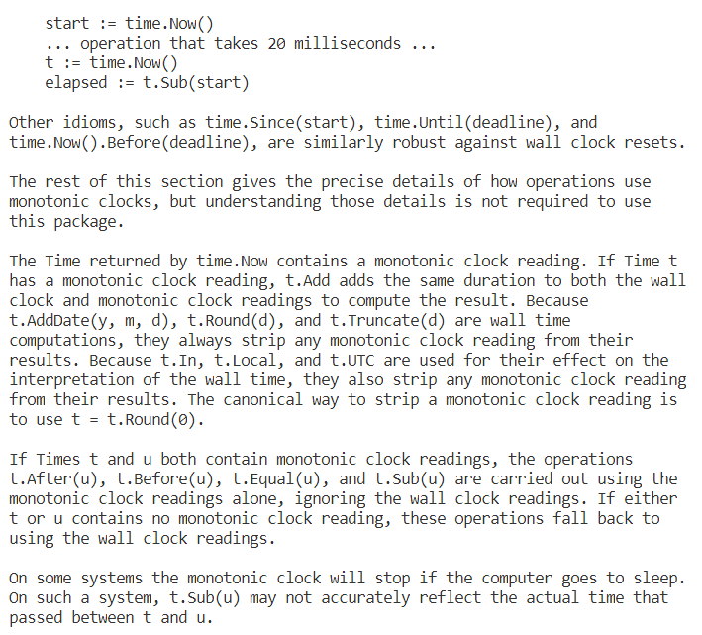
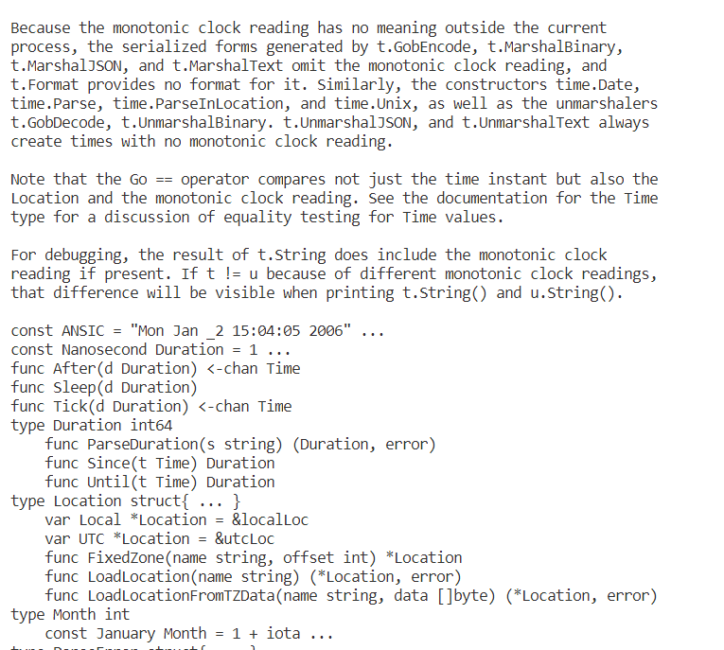
Go Documentation

Slide 60
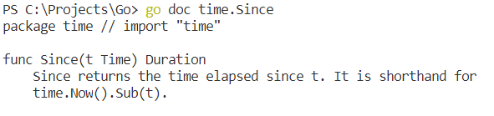
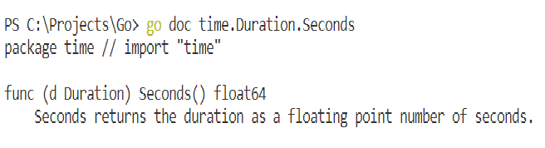
Go Documentation
Or a package member:
Or an exported method:

Slide 61
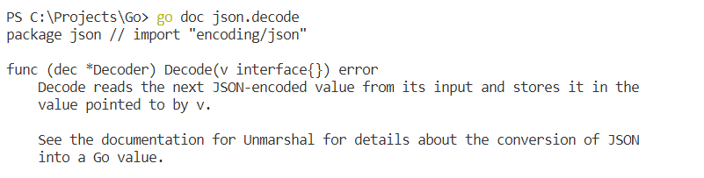
Go Documentation
The tool does not need complete import paths or correct identifier case.
e.g. This command prints doc comments of (*json.Decoder).Decode from the encoding/json package:

Slide 62
Go Documentation
The second tool, confusingly named godoc, serves cross-linked HTML pages that provide same information as go doc tool and even more.
The godoc server at https://golang.org/pkg covers the standard library. The godoc server at https://golang.org has a searchable index of thousands of open-source packages.
You can also run an instance of godoc in your workspace if you wish to browse your own packages, via http://localhost:7001/pkg in your browser while running this command godoc –http :7001
Need to install library godoc before the above by typing command go get -u golang.org/x/tools/cmd/godoc
Make sure that the directory that godoc is installed is added to the Path environment variable.

Slide 63
Idiomatic Go
Go is a relatively new language compared to several existing languages.
Athough it borrows ideas from and have some features common with its relatives, a direct translation of C++ , Java or Python program may not produce a good result, not tapping fully on the benefits that distinctive features of Go could have brought about.
To write good Go programs, it is important to understand and appreciate the conventions in Go programming, the programming language’s properties and idioms.
Now we will discuss the various aspects and tips for writing clear, idiomatic Go code.

Slide 64
Idiomatic Go - Formatting
There's no need to spend time lining up the comments on the fields of a structure. Gofmt will do that for you.
Gofmt is a tool that automatically formats Go code.
Given the declaration
gofmt will line up the columns:
type T struct {
name string // name of the object
value int // its value
}
type T struct {
name string // name of the object
value int // its value

Slide 65
Idiomatic Go - Formatting
To format your code, you can use the gofmt tool directly:
Or you can use the go fmt command:
gofmt -w yourcode.go
go fmt path/to/your/package

Slide 66
Idiomatic Go - Formatting
Line length
Go has no line length limit. Don't worry about overflowing. If a line feels too long, wrap it and indent with an extra tab.
Parentheses
Go needs fewer parentheses than C and Java: control structures (if, for, switch) do not have parentheses in their syntax. Also, the operator precedence hierarchy is shorter and clearer, so x<<8 + y<<16

Slide 67
Idiomatic Go - Commentary
Go provides C-style /* */ block comments and C++-style // line comments. Line comments are the norm; block comments appear mostly as package comments, but are useful within an expression or to disable large swaths of code.
Comments that appear before top-level declarations, with no intervening newlines, are extracted by godoc along with the declaration to serve as explanatory text for the item. The nature and style of these comments determines the quality of the documentation godoc produces.

Slide 68
Idiomatic Go - Commentary
Every package should have a package comment, a block comment preceding the package clause.
For multi-file packages, the package comment only needs to be present in one file, and any one will do.
The package comment should introduce the package and provide information relevant to the package as a whole. It will appear first on the godoc page and should set up the detailed documentation that follows.

Slide 69
Idiomatic Go - Commentary
/*
Package regexp implements a simple library for regular expressions.
The syntax of the regular expressions accepted is:
regexp:
concatenation { '|' concatenation }
concatenation:
{ closure }
closure:
term [ '*' | '+' | '?' ]
term:
'^'
'$'
'.'
character
'[' [ '^' ] character-ranges ']'
'(' regexp ')'
*/
package regexp

Slide 70
Idiomatic Go - Commentary
If the package is simple, the package comment can be brief.
Comments do not need extra formatting such as banners of stars.
The generated output may not even be presented in a fixed-width font, so don't depend on spacing for alignment—godoc, like gofmt, takes care of that.
The comments are uninterpreted plain text, so HTML and other annotations such as _this_ will reproduce verbatim and should not be used.
// Package path implements utility routines for
// manipulating slash-separated filename paths.

Slide 71
Idiomatic Go - Commentary
Depending on the context, godoc might not even reformat comments, so make sure they look good straight up: use correct spelling, punctuation, and sentence structure, fold long lines, and so on.
Inside a package, any comment immediately preceding a top-level declaration serves as a doc comment for that declaration. Every exported (capitalized) name in a program should have a doc comment.
Doc comments work best as complete sentences, which allow a wide variety of automated presentations. The first sentence should be a one-sentence summary that starts with the name being declared.

Slide 72
Idiomatic Go - Commentary
// Compile parses a regular expression and returns, if successful,
// a Regexp that can be used to match against text.
func Compile(str string) (*Regexp, error) {
Go's declaration syntax allows grouping of declarations. A single doc comment can introduce a group of related constants or variables. Since the whole declaration is presented, such a comment can often be perfunctory.
// Error codes returned by failures to parse an expression.
var (
ErrInternal = errors.New("regexp: internal error")
ErrUnmatchedLpar = errors.New("regexp: unmatched '('")
ErrUnmatchedRpar = errors.New("regexp: unmatched ')'")
...
)

Slide 73
Idiomatic Go - Commentary
Grouping can also indicate relationships between items, such as the fact that a set of variables is protected by a mutex.
var (
countLock sync.Mutex
inputCount uint32
outputCount uint32
errorCount uint32
)

Slide 74
Idiomatic Go - Name
Names in Go have semantic effect: the visibility of a name outside a package is determined by whether its first character is upper case.
When a package is imported, the package name becomes an accessor for the contents.
the importing package can access Buffer from bytes via bytes.Buffer.
By convention, packages are given lower case, single-word names; Convention is not to use underscores or mixedCaps.
import "bytes"

Slide 75
Idiomatic Go - Name
The package name is only the default name for imports; it need not be unique across all source code, and in the rare case of a collision the importing package can choose a different name to use locally.
Another convention is that the package name is the base name of its source directory; the package in src/encoding/base64 is imported as "encoding/base64" but has name base64, not encoding_base64 and not encodingBase64.
Use the package structure to help choose good names for packages.

Slide 76
Idiomatic Go - Name
Long names don't automatically make things more readable. A helpful doc comment can often be more valuable than an extra long name.
e.g. once.Do; once.Do(setup) VS once.DoOrWaitUntilDone(setup).
Go doesn't provide automatic support for getters and setters. So sometimes we provide ourselves. If there is field called owner (lower case, unexported), the getter method should be called Owner (upper case, exported), not GetOwner. The use of upper-case names for export discriminate the field from the method. A setter function, if needed, will likely be called SetOwner.

Slide 77
Idiomatic Go - Name
owner := obj.Owner()
if owner != user {
obj.SetOwner(user)
}
Finally, the convention in Go for naming of identifiers is to use MixedCaps or mixedCaps rather than underscores for multiword names.

Slide 78
Idiomatic Go - Semicolons
Idiomatic Go programs have semicolons only in places such as for loop clauses, to separate the initializer, condition, and continuation elements.
Semicolons also necessary to separate multiple statements on a line, should you write code that way.
One consequence of the semicolon insertion rules is that you cannot put the opening brace of a control structure (if, for, switch, or select) on the next line. If you do, a semicolon will be inserted before the brace, which could cause unwanted effects. Write them like this
if i < f() {
g()
}
if i < f() // wrong!
{ // wrong!
g()
}

Slide 79
Idiomatic Go – Control Structures
The control structures of Go are related to those of C but differ in important ways.
There is no do or while loop, only a slightly generalized for.
switch is more flexible; if and switch accept an optional initialization statement like that of for;
break and continue statements take an optional label to identify what to break or continue;
there are new control structures including a type switch and a multiway communications multiplexer, select. The syntax is also slightly different: there are no parentheses and the bodies must always be brace-delimited.

Slide 80
Idiomatic Go – Control Structures
// Like a C for
for init; condition; post { }
// Like a C while
for condition { }
// Like a C for(;;)
for { }

Slide 81
Idiomatic Go – Control Structures
Go's switch is more general than C's. The expressions need not be constants or even integers,
the cases are evaluated top to bottom until a match is found. There is no automatic fallthrough.
func unhex(c byte) byte {
switch {
case '0' <= c && c <= '9':
return c - '0'
case 'a' <= c && c <= 'f':
return c - 'a' + 10
case 'A' <= c && c <= 'F':
return c - 'A' + 10
}
return 0
}

Slide 82
Idiomatic Go - Functions
One of Go's unusual features is that functions and methods can return multiple values. This form can be used to improve on a couple of clumsy idioms in C programs: in-band error returns such as -1 for EOF and modifying an argument passed by address.
In C, a write error is signaled by a negative count with the error code.
In Go, write can return a count and an error. And go programmers are encouraged to check for the error and handle it before writing any code for the case if no error occurs.

Slide 83
Idiomatic Go – Named result parameters
The return or result "parameters" of a Go function can be given names and used as regular variables, just like the incoming parameters.
When named, they are initialized to the zero values for their types when the function begins;
if the function executes a return statement with no arguments, the current values of the result parameters are used as the returned values.
The names are not mandatory but they can make code shorter and clearer. If we name the results of nextInt it becomes obvious which returned int is which.

Slide 84
Idiomatic Go - Defer
Go's defer statement schedules a function call (the deferred function) to be run immediately before the function executing the defer returns.
It's an unusual but effective way to deal with situations such as resources that must be released regardless of which path a function takes to return. Examples are unlocking a mutex or closing a file.

Slide 85
Idiomatic Go – Blank Identifier
The blank identifier can be assigned or declared with any value of any type, with the value discarded harmlessly. (a bit like writing to the Unix /dev/null file)
It represents a write-only value to be used as a place-holder where a variable is needed but the actual value is irrelevant. It has uses beyond those we've seen already.
It is used in
Multiple assignments
If an assignment requires multiple values on the left side, but one of the values not used by the program, a blank identifier on the left-hand-side of the assignment avoids the need to create a dummy variable, and makes it clear that the value is to be discarded.

Slide 86
Idiomatic Go – Unused package import
It is an error to import a package or to declare a variable without using it.
Unused imports bloat the program and slow compilation.
When a program is under active development, however, unused imports and variables often arise and it can be annoying to delete them just to have the compilation proceed, only to have them be needed again later. The blank identifier provides a workaround.

Slide 87
Idiomatic Go
What we went through is only a fraction of considerations when talking about good ways to code in Go.
There are several discussion and comments among the community about Go style.
Here are some further reference that you can refer to:
https://github.com/golang/go/wiki/CodeReviewComments
https://dmitri.shuralyov.com/idiomatic-go

